Slide 1

SpaceVoyage: Exploring space with AI innovation

Slide 2
CORE TEAM MEMBERS
Team Member | Project Role
Deepthi Peddisetti | Project manager
Devineni Asritha | AI specialist
Gowtham Manikanta Chilukabathula | Data scientist
Venkateswarlu Jyogi | Space analyst
Purushotham Reddy Koduri | Financial analyst
Bhanuprasad Unnam | AI Ethics expert

Slide 3
INTRODUCTION
This project is all about our revolutionizing the space with the help of artificial intelligence.
It helps to optimize and allocate and predict the weather space weathers with accurate values and helps in field of a research.
In collaboration with various space oriented sectors it helps the public audience to engage to it and also beneficial with respect to the student educational programmes.

Slide 4
OBJECTIVE
Increase accessibility of the data: Has to be provided all to all the researchers and the analysis that are oriented to the project
Prediction of weather: Along with prediction of weather we also this project also talks about how the various astronomical events going to influence the conditions in the globe.
Engagement of students in a space oriented topics: We try to engage the students to create an interest towards a space exploration

Slide 5
PROJECT MILESTONE
Summary Milestone Schedule – List key project milestones relative to project start.
Project Milestone | Target Date (mm/dd/yyyy)
Phase I Complete | 02/28/2025
Phase II Complete | 03/20/2025
Phase III Complete | 04/12/2025
Phase IV Complete | 04/26/2025
Phase V Complete | 05/20/2025

Slide 6
WORK BREAK-DOWN STRUCTURE
Project initiation
Mission Planning
Designing
AI development
Spacecraft Manufacturing and Assembly
Testing
Pre-launch
Launch preparation
Deployment
Post analysis

Slide 7
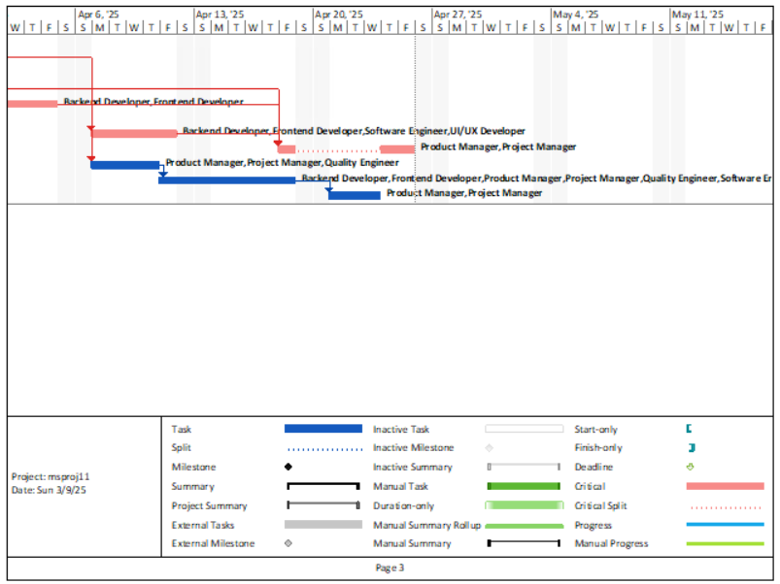
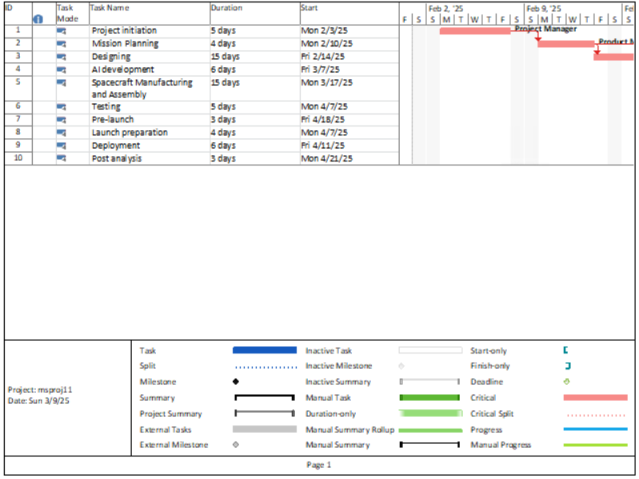
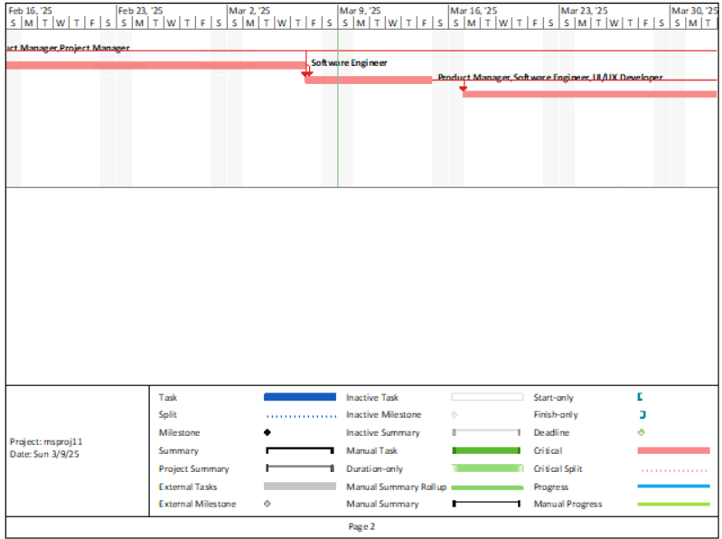
GANTT CHART AND CRITICAL PATH

Slide 8
PROJECT BUDGET
Project Phase | Budgeted Total
Planning | $500
Execution: Design | $690
Execution: Coding | $760
Execution: Testing | $590
Monitoring/Controlling: Quality | $450
Monitoring/Controlling: Integration & Change Management | $870
Close-out: Transition and Closeout | $430
Contingency | $1000

Slide 9
PROJECT PERFORMANCE
Key Resource/Process/Service | Performance Measure
Accessibility of space data | This is being measured using a number of downloads from the website
Collaboration | This is measured using number of partnerships and collaboration that is being done in the project
AI optimization and utilization | This is measured using the number of AI driven plans

Slide 10
STRATEGIC ALIGNMENT
Plan | Goals/Objectives | Relationship to Project
Strategy that is oriented to cost reduction | Minimize the expense | Reducing the cost regarding resource allocations and artificial intelligence integration
Technological innovation | Developing a best technological model | Providing advanced space mission models using the real time data.

Slide 11

The various communication management approach involved in this project includes a structured messaging which takes up regular basis either biweekly or monthly ones with the stakeholders and other vendors.
There will be centralized communication up which includes documentation updates which are easily accessible to the all members of the organization.
There will be a proper communication channel between the stakeholders and the organization
There should be a proper feedback system and mechanism to be initiated so that the team members on the stakeholders takes up few surveys for the updation of the project and for gradual improvement in the practice that has been taken up.
COMMUNICATION MANAGEMENT APPROACH

Slide 12
COMMUNICATION MATRIX
Communication Type | Objective of Communication | Medium | Frequency | Audience | Owner | Deliverable | Format
Review meetings | Addressing various types of resources which are under risk | Video conference | Monthly once | Risk manager risk management team project team | Risk manager | Risk registered assessment reports | Digital documents
Review on design and user interface | Reviewing the existing design and the updates can be infused into it | Virtual meeting | Monthly | Designing team and stakeholders | Designinglead | Designing report and summary | Digital documentation
Change control meetings | Changes has to be initiated to the project for its betterment | Video conference | Biweekly | Change control board project manager | Change management manager | Change request | Digital documentation

Slide 13
COMMUNICATION ESCALATION PROCESS
Priority | Definition | Decision Authority | Timeframe for Resolution
Priority 1 | Critical issues and impacting the milestone of the project | technical team | 72 hours
Priority 2 | Minor issues are with minimalistic impact in the progression of the project | Project coordinator | One week
Priority 3 | A moderate issue but has to be addressed to the stakeholders | Project Manager | One day

Slide 14
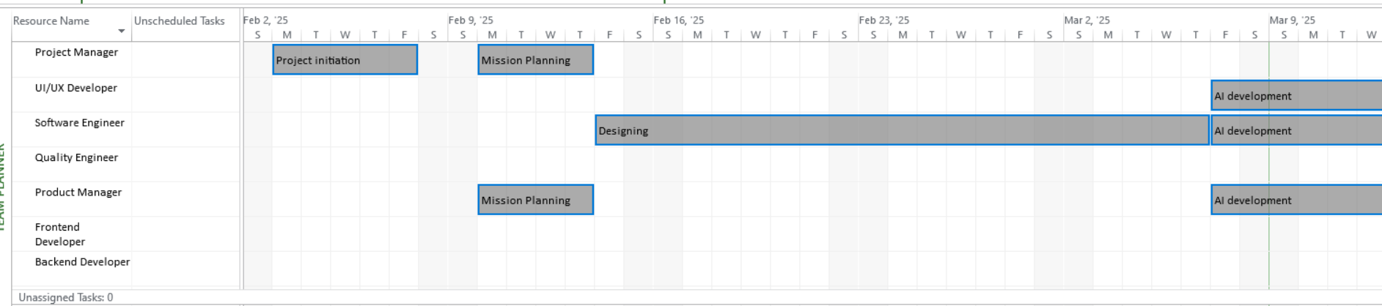
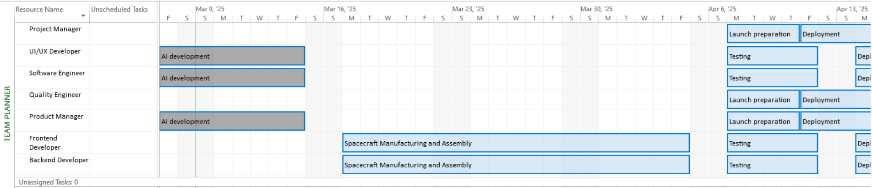
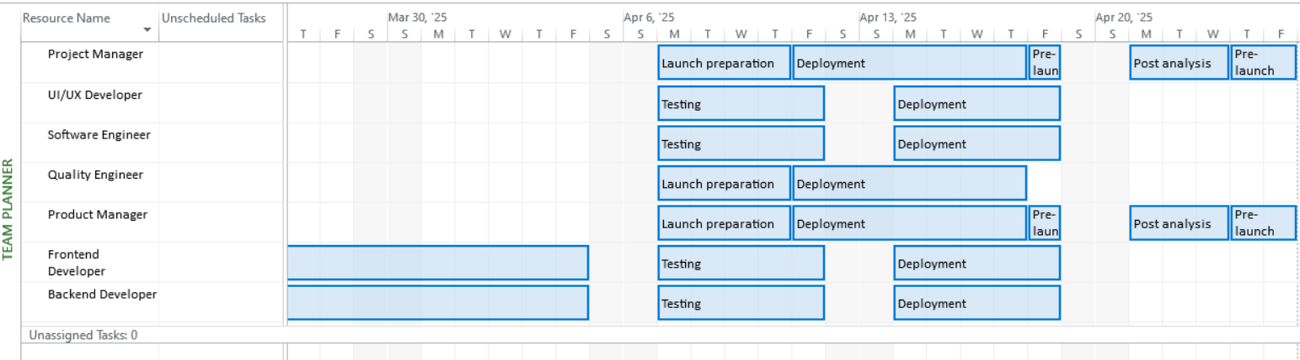
Resource Calendar

Slide 15
RISK MANAGEMENT PLAN
We should conduct a workshop regarding the risk management and have a expert advice and comparing with a historical data.
We should prioritise the rest based upon the probability impact matrix and assign a response for each risk identify and rank them accordingly.
We are supposed to create a proper action plan as well as develop certain contingency plans in order to mitigate the risk.
Then documentation is another approach where we will be using stunt price formats in order to maintain an update all the risk identified.

Slide 16
RISK PRIORITIZATION
Risk Identified | Probability | Impact
Technical failures with respect to both hardware and software compatibility | Medium | Medium
Budget overruns | Medium | High
Resource availability | High | Medium

Slide 17

PROJECT ACCEPTANCE
This project handles a documentation of complete set of records or successfully meeting all the deliverables and acceptance criteria based up on the project charter and scope statement.
Initially the project reviews are considered in the acceptance criteria compilers this project being an ai powered space exploration system it has been successfully deployed.
In addition to this there was a numerous autonomous navigation systems along with prediction in the machine planning as well as deep learning for space communications and so on mapping completely established.
The system excellently integrates with the hardware machine control.
The performance and product verification has been done as a part of space object recognition hazard detection decision making has been advised through various testing phases.
A secured cloud infrastructure is being implemented with a superfast or data transmission along with high yield storage quantity for better redundancy.
Regarding the source evaluation it shows extensive simulation in the testing phase which also includes a zero gravity conditions or space latency.

Slide 18
Measurable Organization Value
Specific: Regarding data accessibility it is much more specific about the centralized space data
Measurable: A measurable includes the cost and the accuracy the researchers and analysts provide. THE COST IS EXPECTED TO BE REDUCED BY 35%
Attainable: Since the project use existing data sometimes the data management has to be processed along with artificial intelligence in order to optimize the resources.
Realistic: Collaborating with financial analysts regarding the planning systems will be very much realistic. WE ARE EXPECTING INCREASE IN THE MARKET SHARE BY 40%
Time-Bound: In order to achieve the cost reductions and development process it will take about six months of time duration.

Slide 19

LESSON LEARNED
The major lesson that was relevant to us was with the help of the life cycle phase like initiation phase planning phase and exhibition phase help us to manage uncertainty in the concept.
Then over here artificial intelligence rate a crucial role in predictive models and helps in decision making systems with respect to the real time space work.
With clear communication and sharing of documents were very much essential and worked in a smooth manner even in times of complex project.

Slide 20
THANK YOU

